Slide 1
Queue up websites
Goal Bounding Demo: https://www.movingai.com/SAS/BBX/
Nathan Explanation: https://youtu.be/__ZLnTwYNPk

Slide 2
Artificial Intelligence for Games Week 5 – Pathfinding 4 Steve Rabin
For help on projects, email everyone (select and copy this string from the start of any class PowerPoint):
steve.rabin@gmail.com, p.jiankai@digipen.edu, b.hsu@digipen.edu, zak.s@digipen.edu, keaton.sullivan@digipen.edu, john.tseng@digipen.edu, a.roulst@digipen.edu
TAs: Jian Kai Phua, Brandon Hsu, Zak Stephenson, Keaton Sullivan, John Tseng, Andrew Roulst

Slide 3
Questions
Why is hierarchical pathfinding so much faster?
For A* on a grid, what is the best general purpose heuristic?
What is good about overestimating the heuristic in A*?
What is bad about overestimating the heuristic in A*?
Name three data structures that can be used for the Open list in A*.
Which A* operations must be supported by the Open list data structure?

Slide 4
JPS+: Over 100x Faster than A* Steve Rabin Principal Lecturer DigiPen Institute of Technology

Slide 5
JPS+: Over 100x Faster than A* JPS+ now with Goal Bounding: Over 1000x Faster than A*

Slide 6

Coming out April 2015
…however, back in
June 2014…
…however,
2 months ago…

Slide 7
Two Primary Techniques (Node Pruning)
JPS+ (ICAPS July 2014)
“Avoid redundant paths on grids”
Goal Bounding (developed in Jan 2015)
“Avoid wrong directions on any kind of map”

Slide 8
Test Maps (movingai.com)
75 StarCraft maps (198,230 problems)
156 Dragon Age Origins maps (159,465 problems)
36 Warcraft III maps (50,971 problems)

Slide 9
Test Maps (movingai.com)
75 StarCraft maps (198,230 problems)
156 Dragon Age Origins maps (159,465 problems)
36 Warcraft III maps (50,971 problems)

Slide 10
A*
JPS+
JPS+ Goal Bounding

Slide 11
A*
JPS+
JPS+ Goal Bounding

Slide 12
A*
JPS+
JPS+ Goal Bounding

Slide 13
A*
JPS+
JPS+ Goal Bounding

Slide 14
A*
JPS+
JPS+ Goal Bounding

Slide 15
Goal Bounding
JPS+
70x to 350x
faster
1400x to 5000x
faster
20x to 60x
faster
Avoid
Redundant
Paths
Avoid
Wrong
Directions

Slide 16
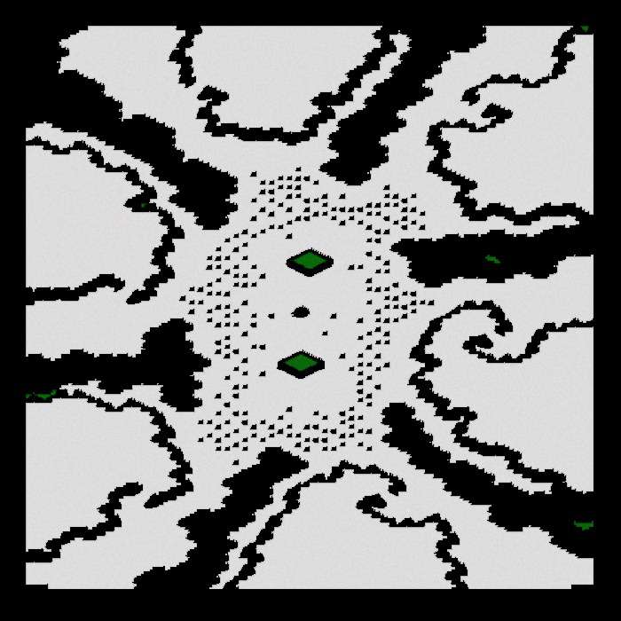
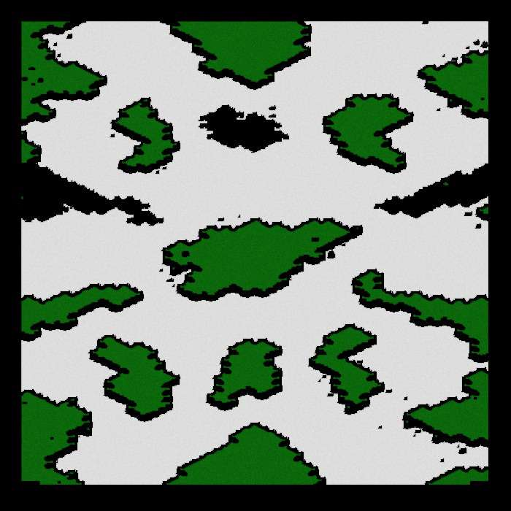
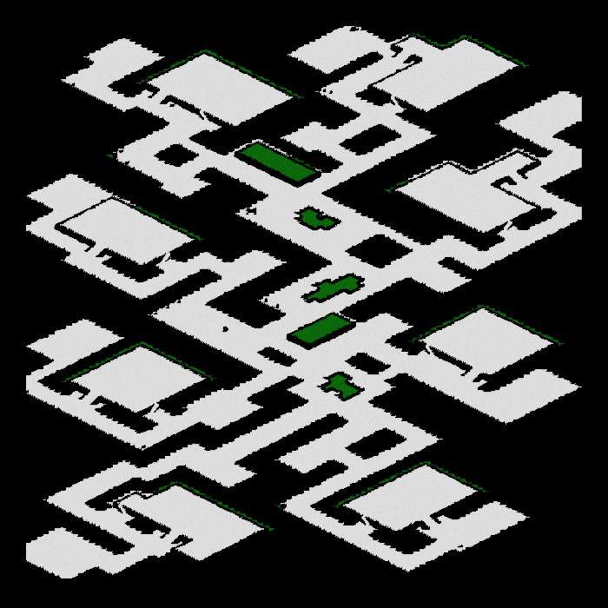
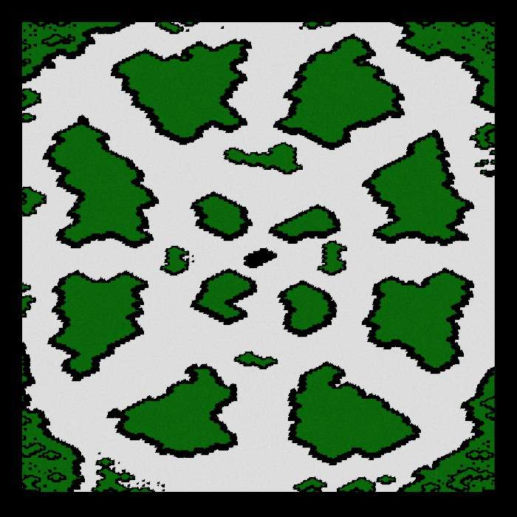
StarCraft Maps: JPS+

Slide 17
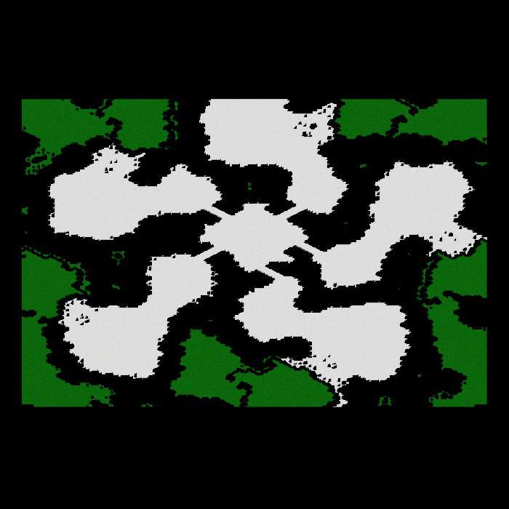
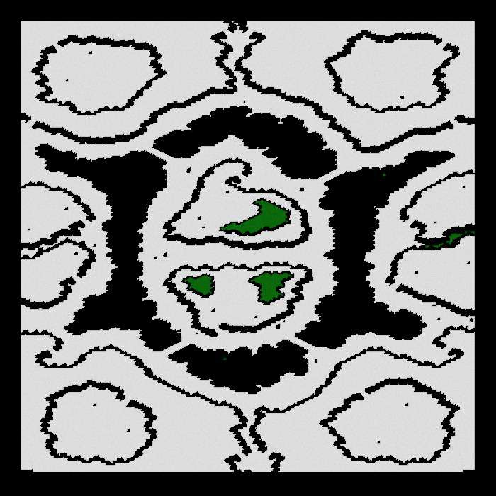
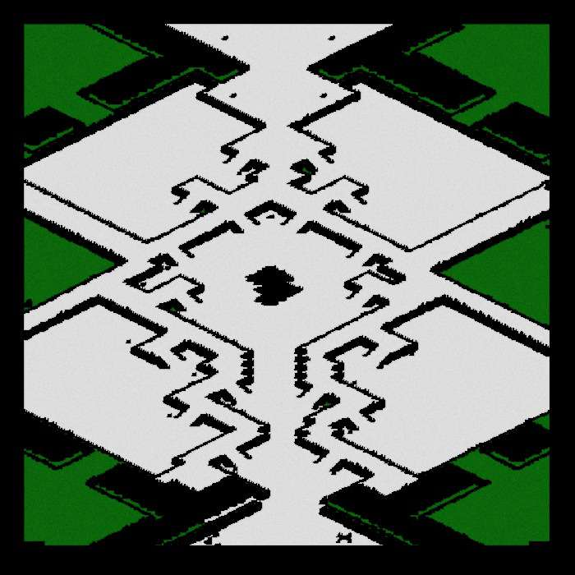
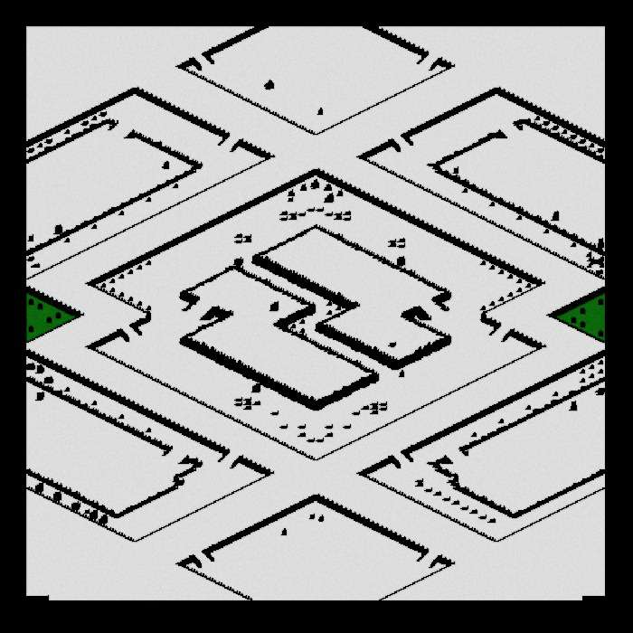
StarCraft Maps: Subgoal Graph

Slide 18
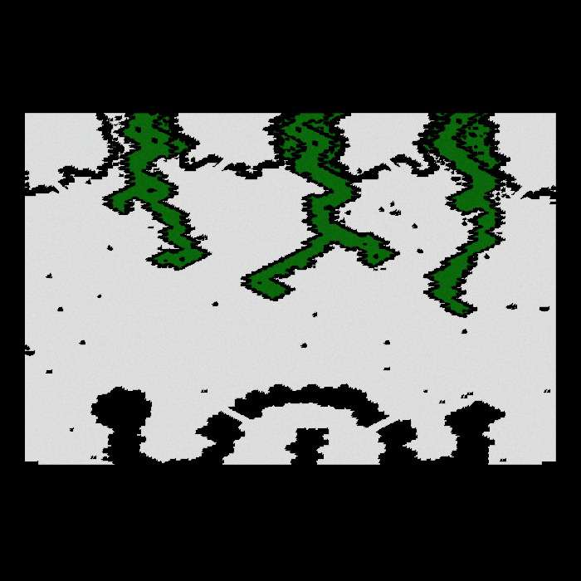
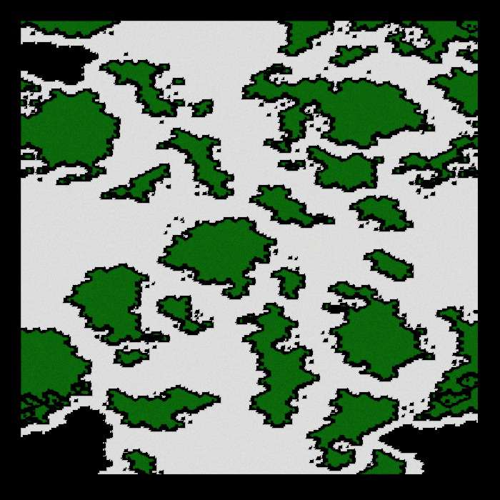
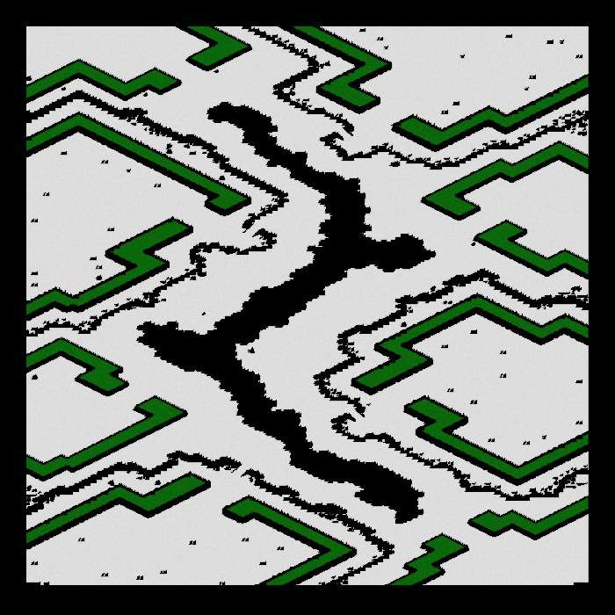
StarCraft Maps: JPS+ Goal Bounds

Slide 19
StarCraft Maps: Comparison
JPS+
Subgoal Graph
JPS+ Goal Bounds

Slide 20
StarCraft Maps: Comparison
JPS+
Subgoal Graph
JPS+ Goal Bounds

Slide 21
Goal Bounding
1 value
Per Edge
4 values
Per Edge
JPS+
Grids, NavMesh, Graphs
Fast O(n)
Precompute
Slow O(n²)
Precompute
No Map
Changes
Dijkstra, A*,
other algorithms
Uniform
Cost
Avoid
Redundant
Paths
Avoid
Wrong
Directions
Non-Uniform
Cost

Slide 22
Overview
JPS+ Preprocessing & Runtime
Goal Bounding Preprocessing & Runtime
Results and Analysis
Future Work

Slide 23
JPS+ Explained

Slide 24
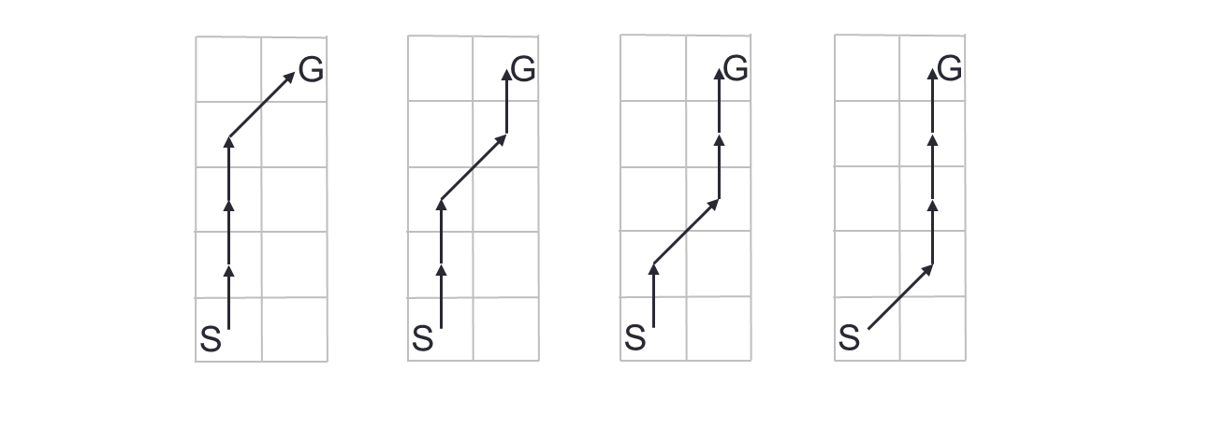
Equivalent Paths on Grids

Slide 25
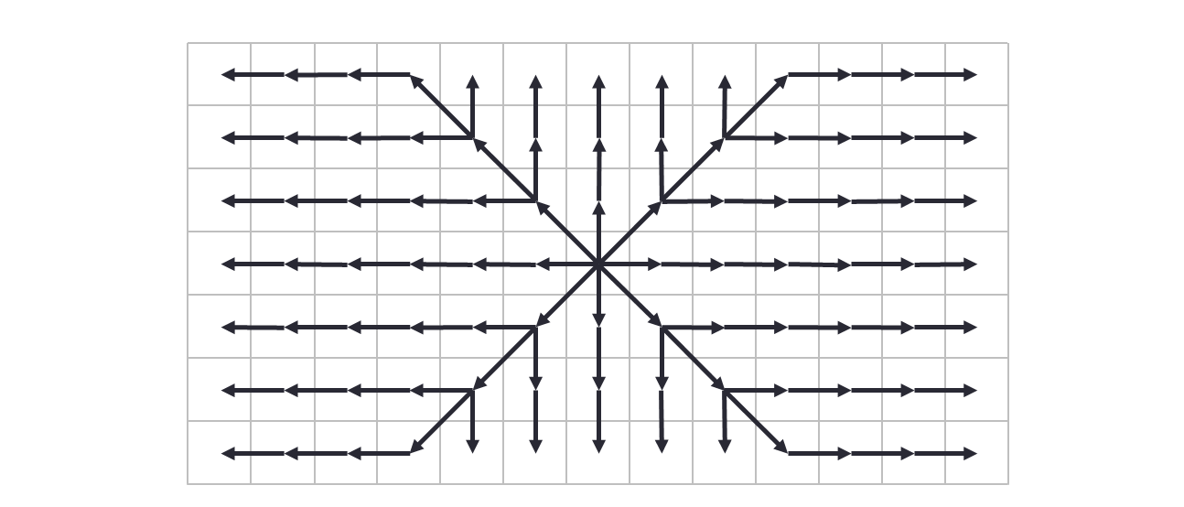
JPS Search Strategy
Only got 1 neighbour to check

Slide 26
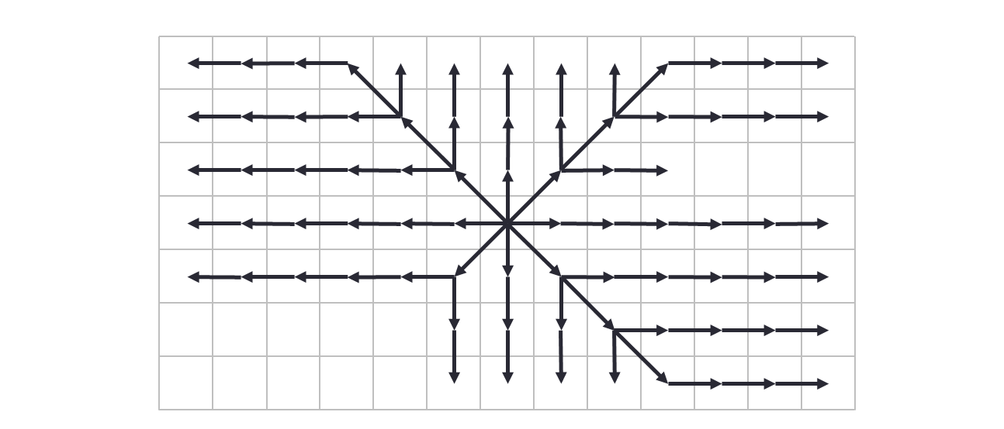

JPS Search Strategy
But if got wall, whole are gone

Slide 27
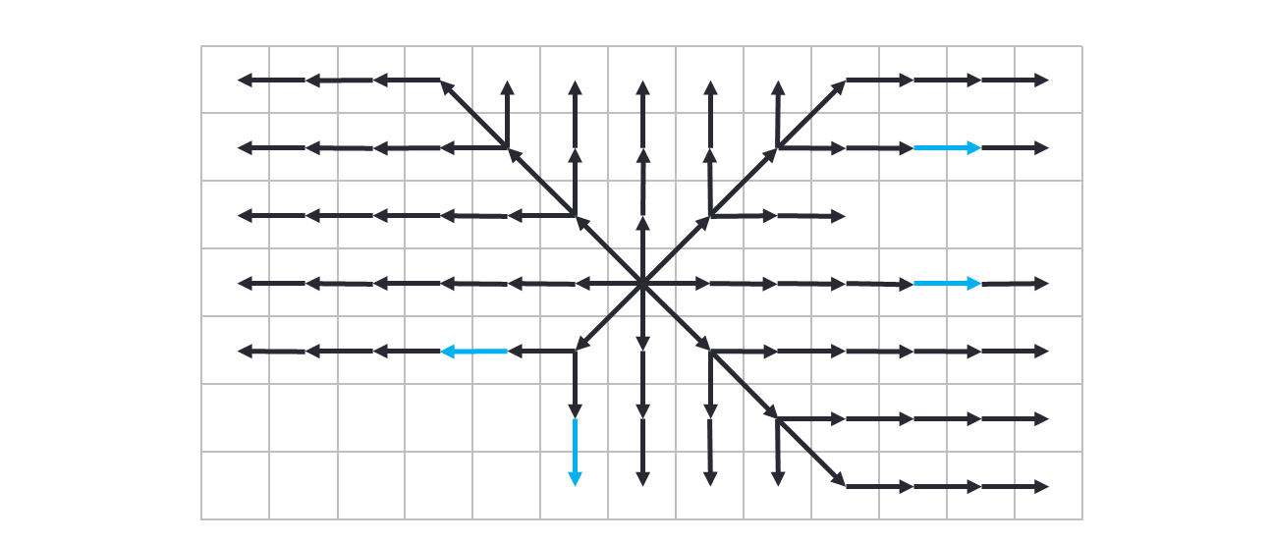

JPS Search Strategy

Slide 28
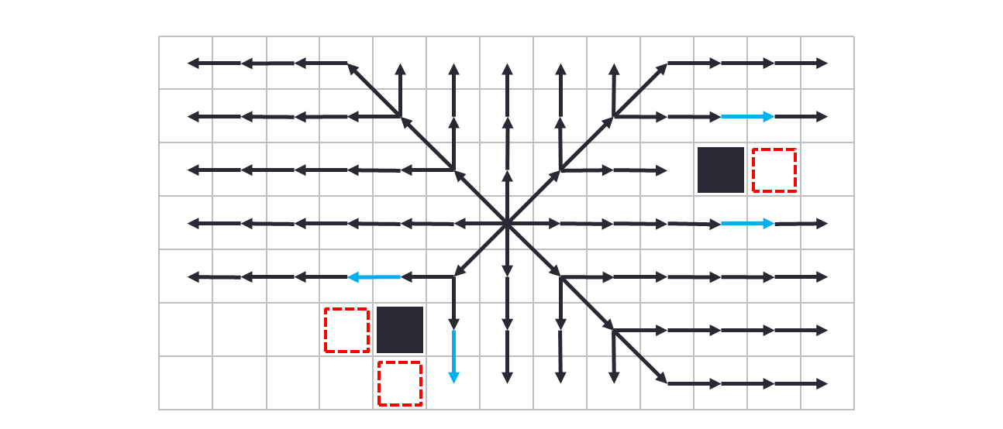
JPS Search Strategy

Slide 29
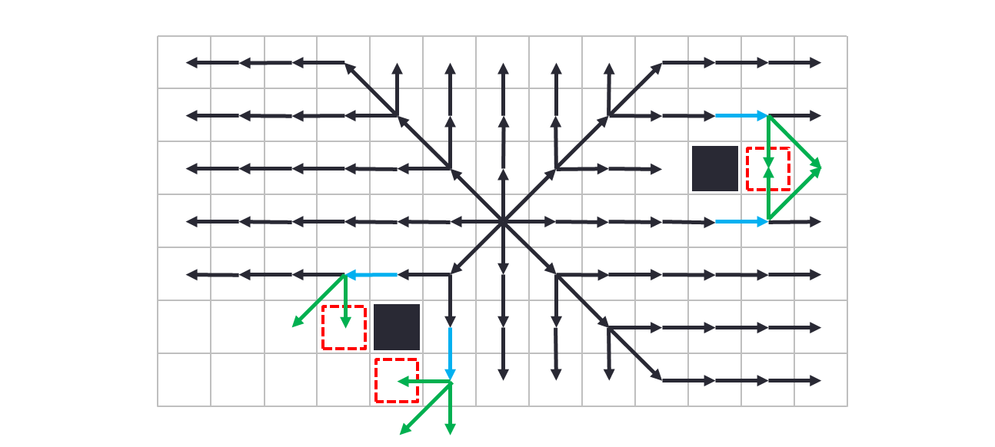
JPS Search Strategy

Slide 30
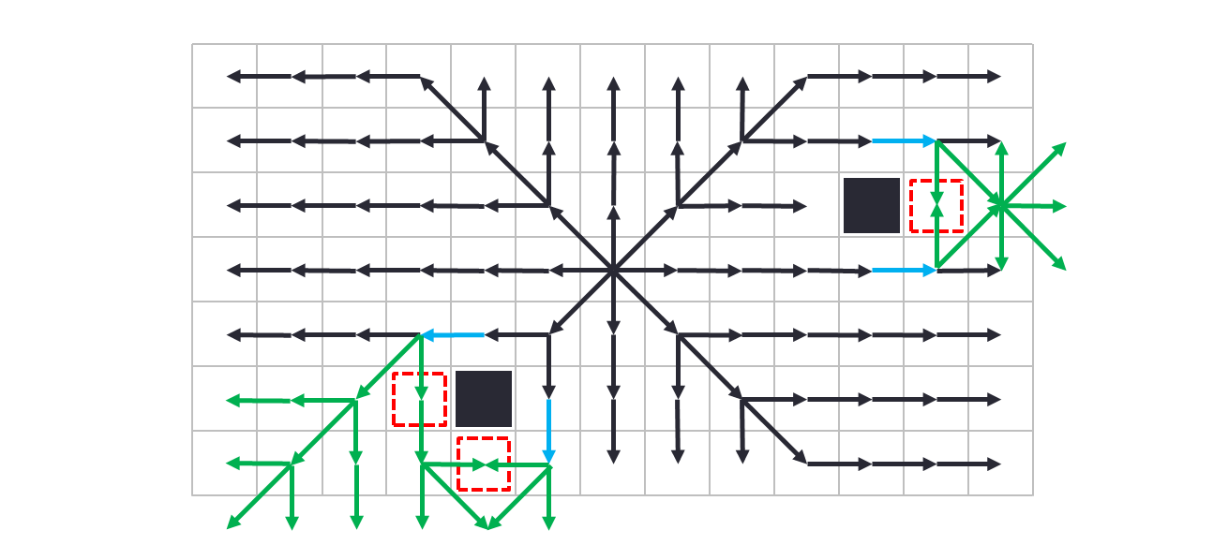
JPS Search Strategy
Create a “force number” to access the other squares

Slide 31
Forced Neighbor Cases

Slide 32
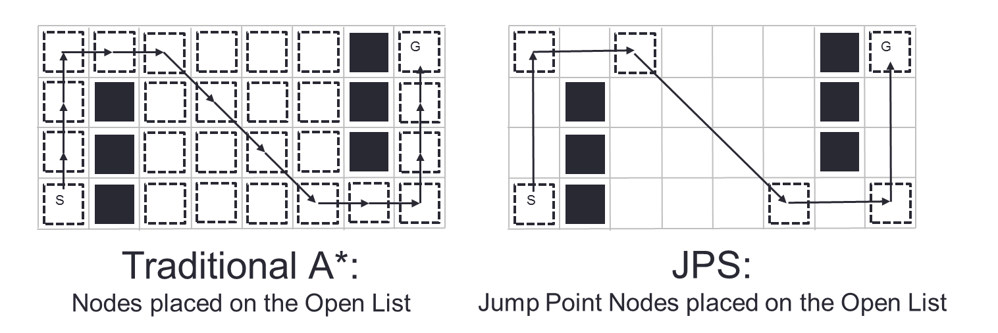
Fewer Open List Nodes

Slide 33
Four Types of Jump Points
Primary
Straight
Diagonal
Target

Slide 34
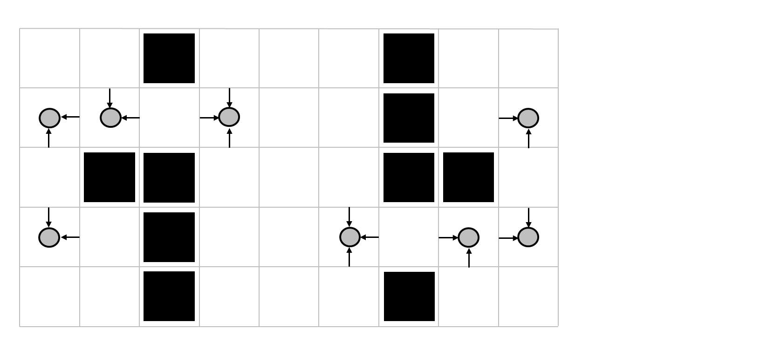
Primary Jump Points
Set jump point on each direction

Slide 35
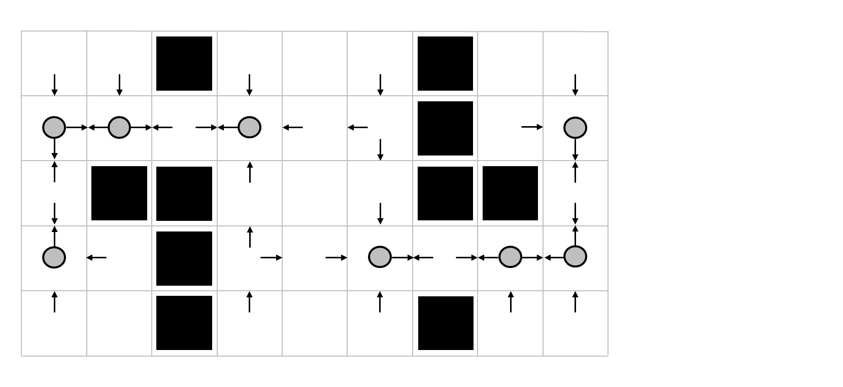
Straight Jump Points

Slide 36
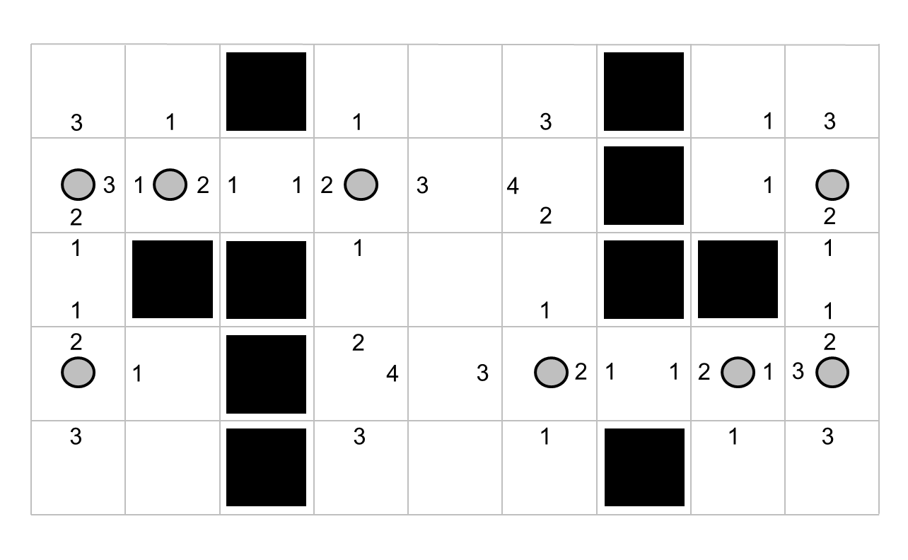
Straight Jump Point Distance

Slide 37
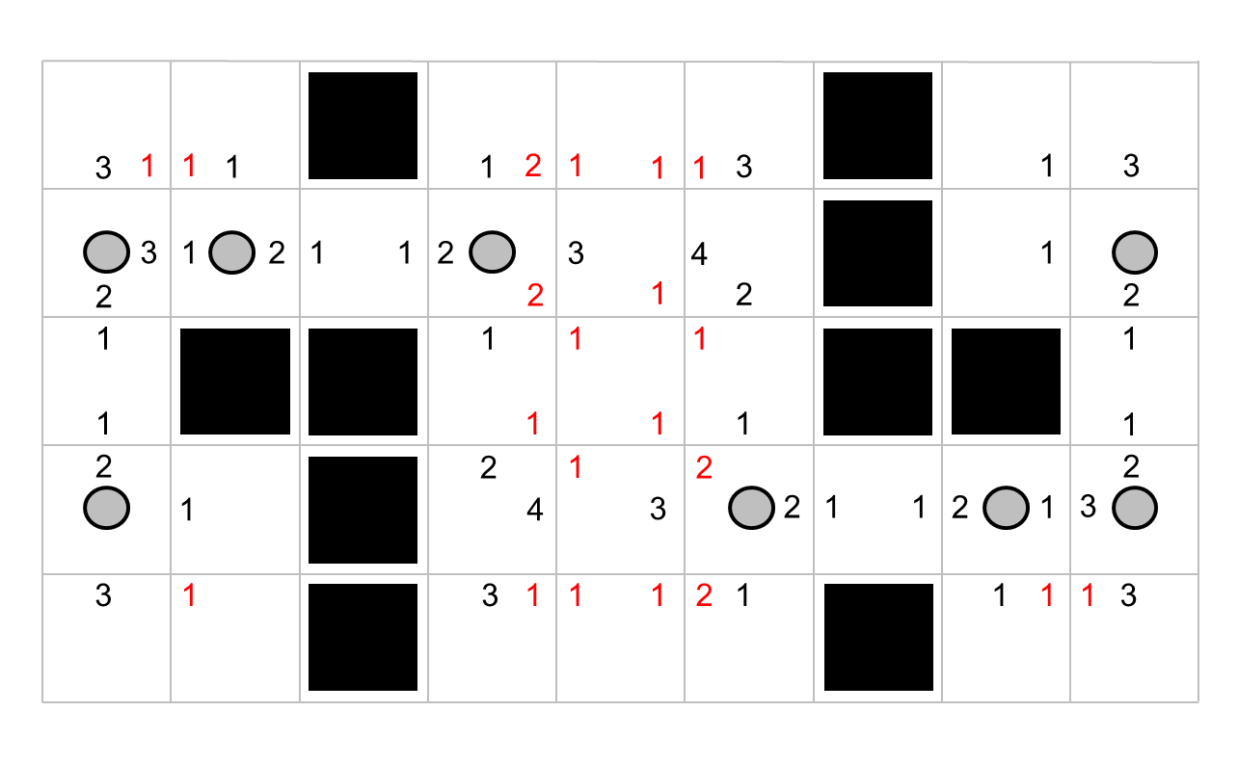
Diagonal Jump Points

Slide 38
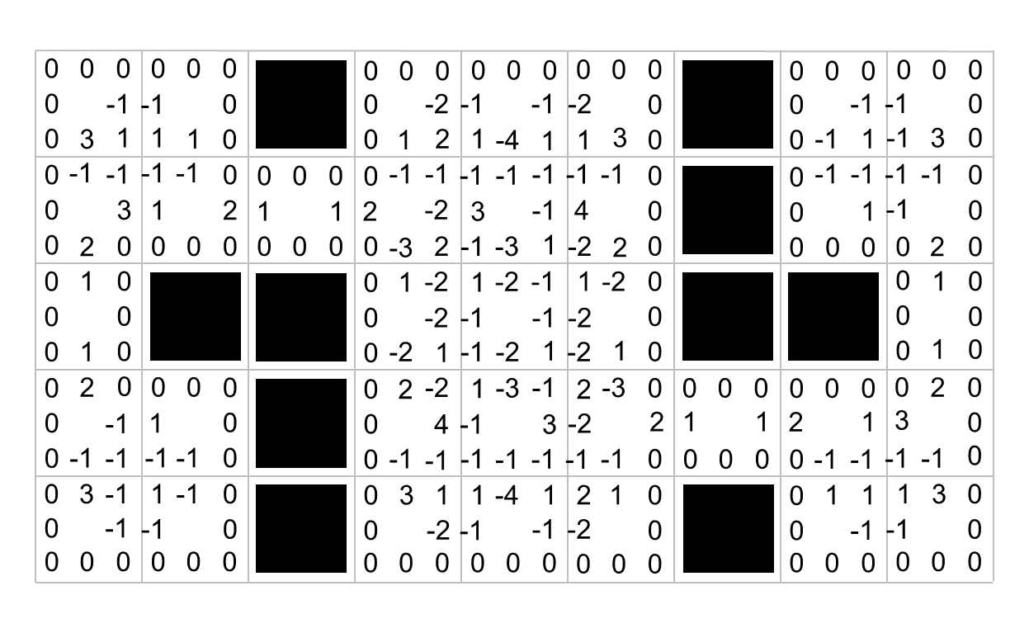
Add in Wall Distances (0 or neg)

Slide 39
Four Types of Jump Points
Primary
Straight
Diagonal
Target (runtime)

Slide 40
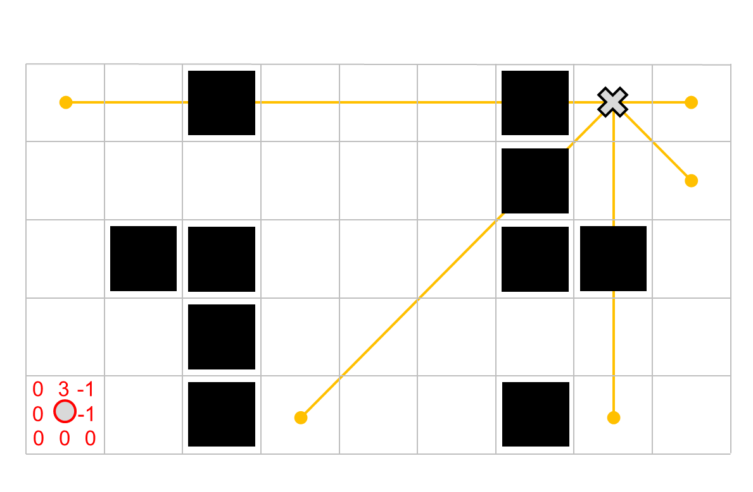
JPS+ Runtime Example

Slide 41
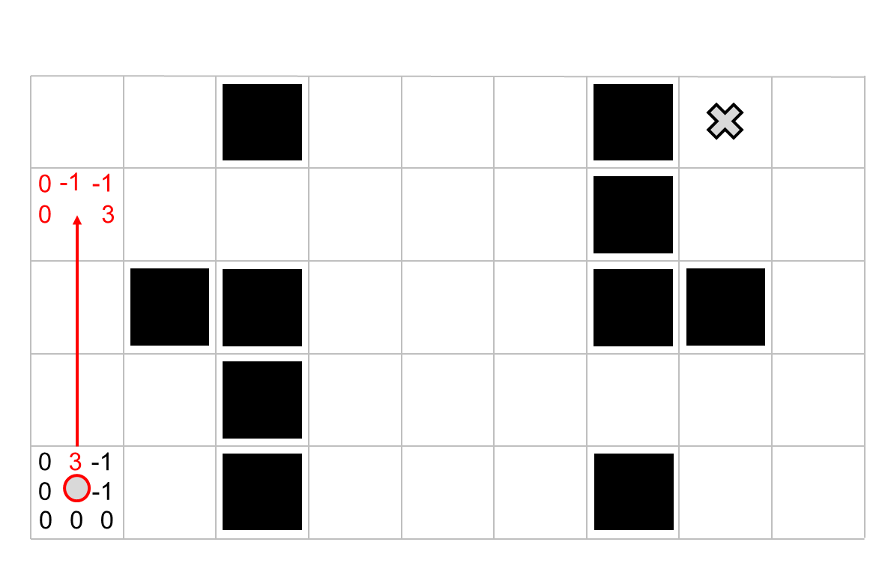

Slide 42
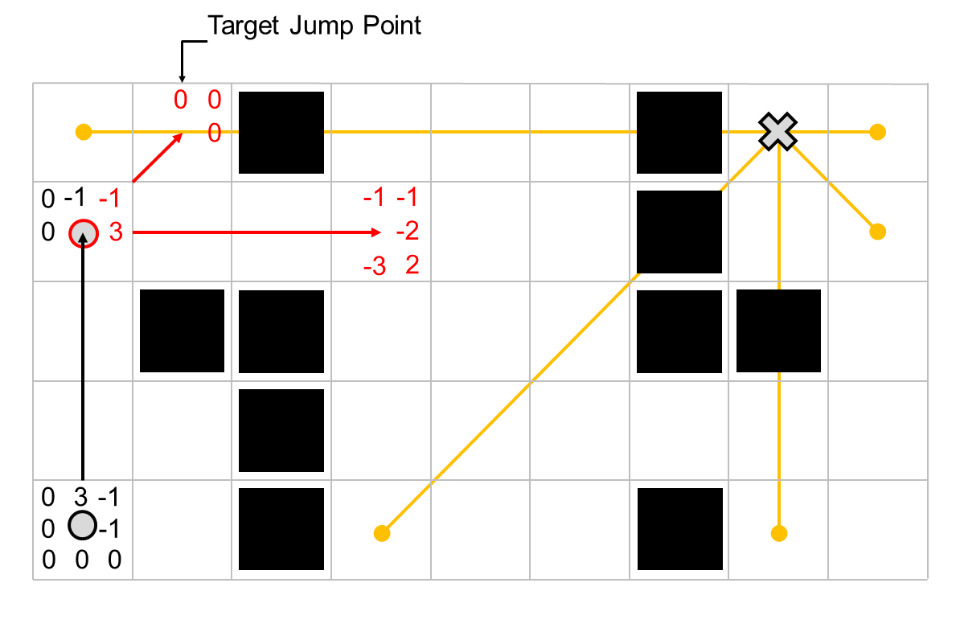

Slide 43
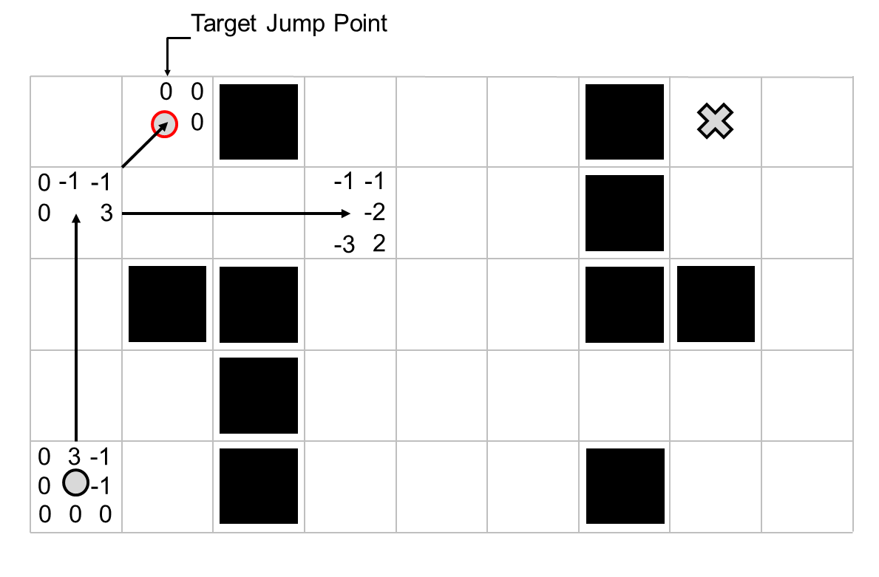

Slide 44
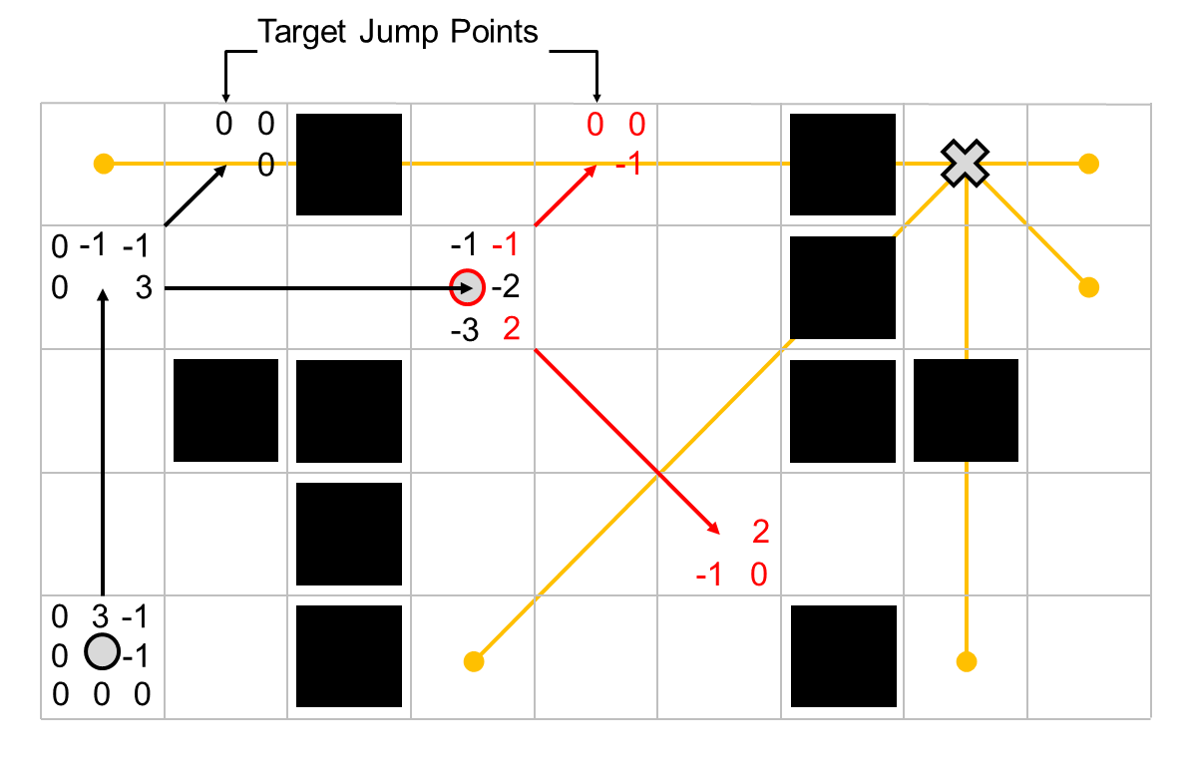

Slide 45
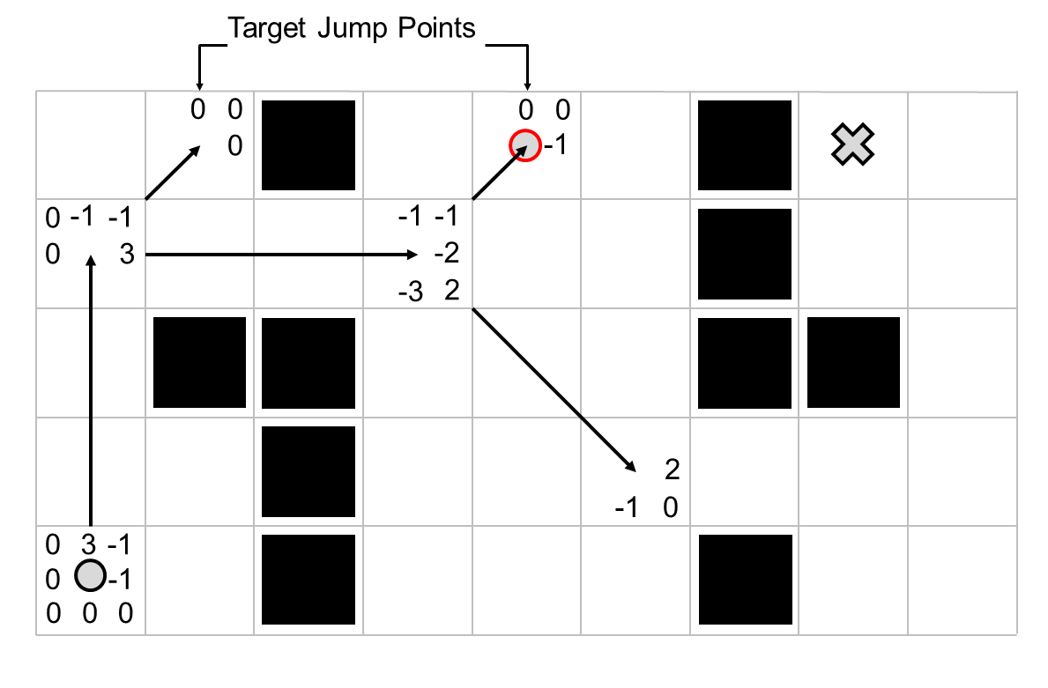

Slide 46
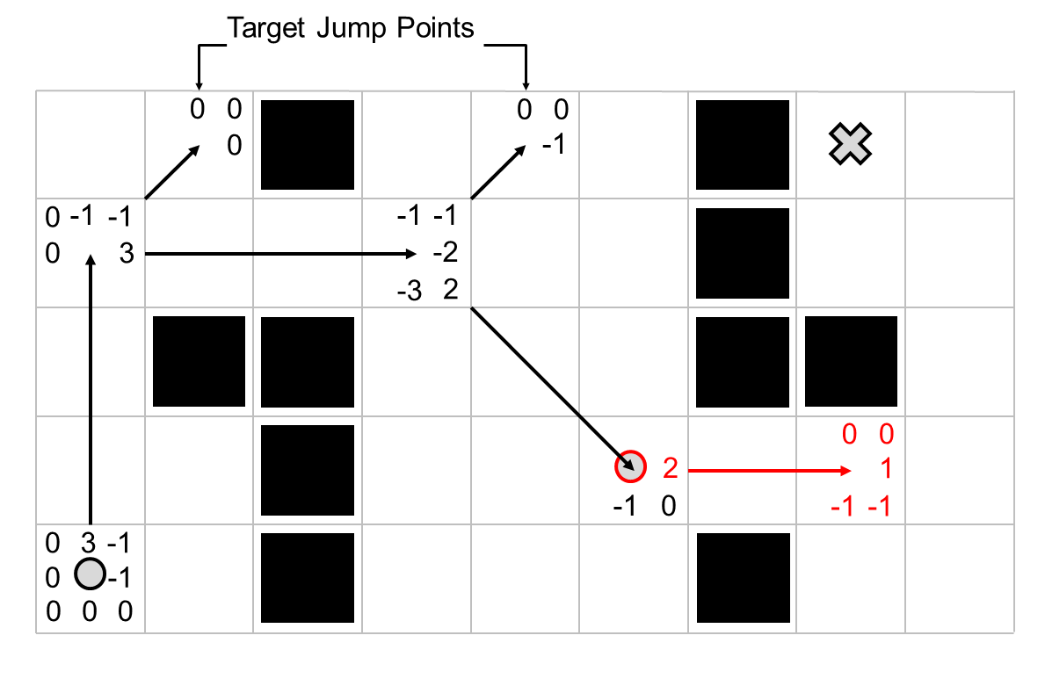

Slide 47
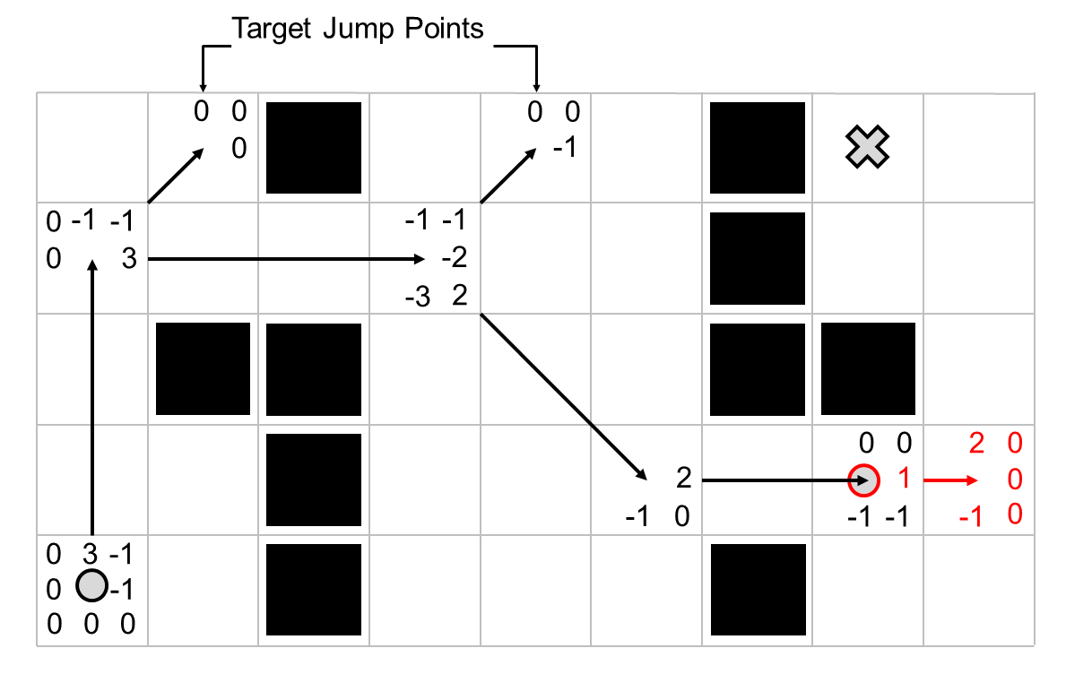

Slide 48
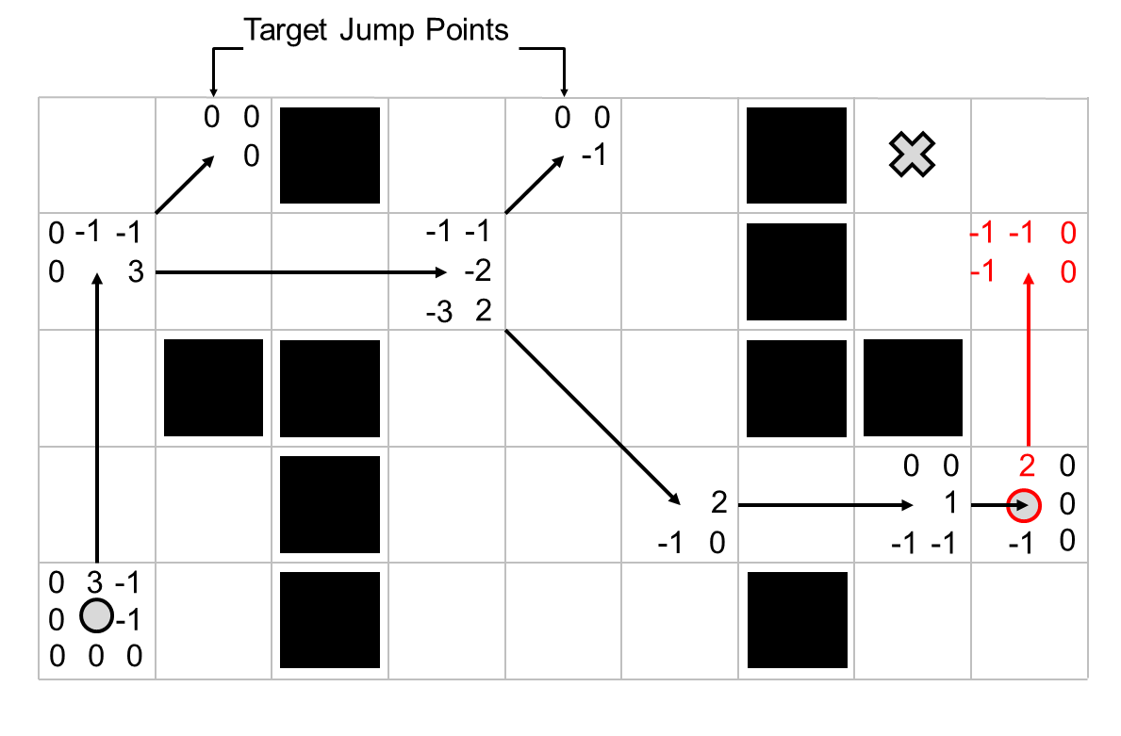

Slide 49
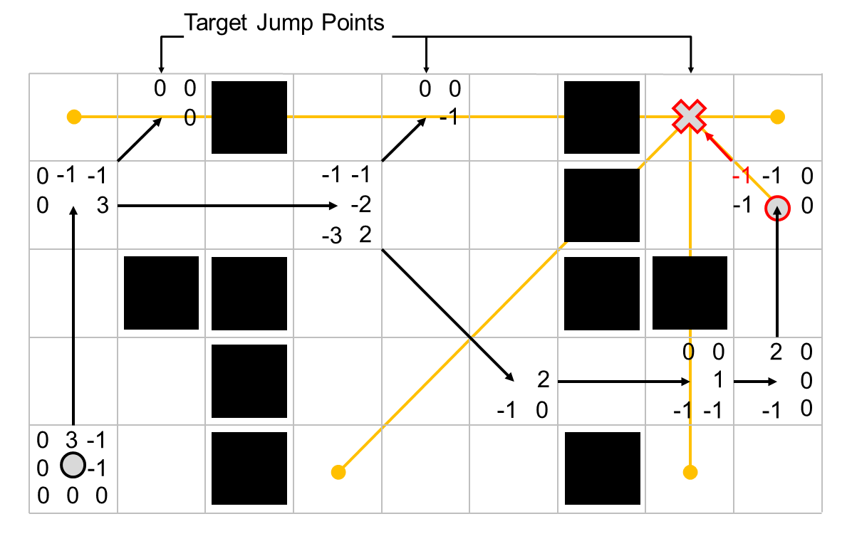

Slide 50
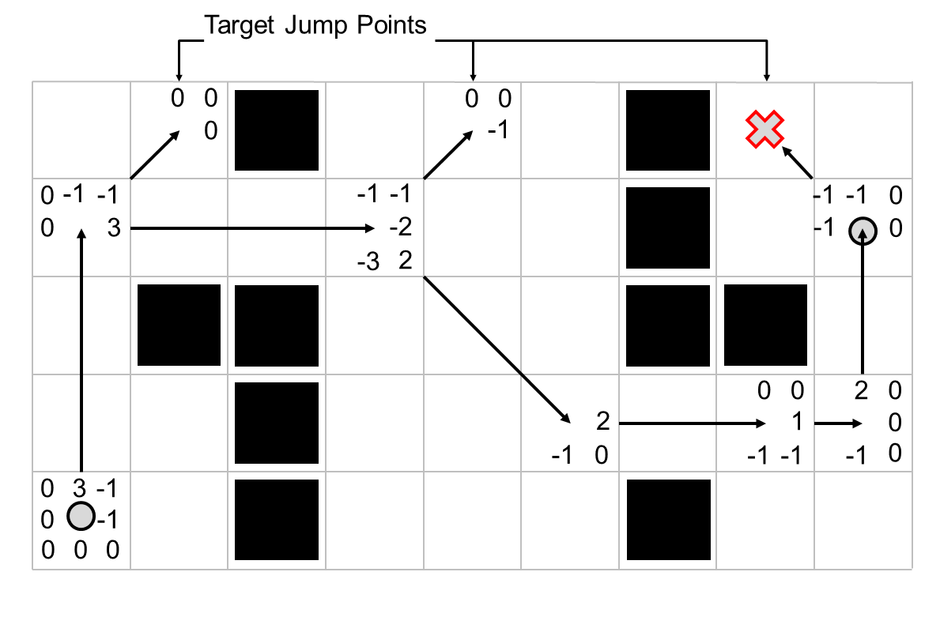

Slide 51
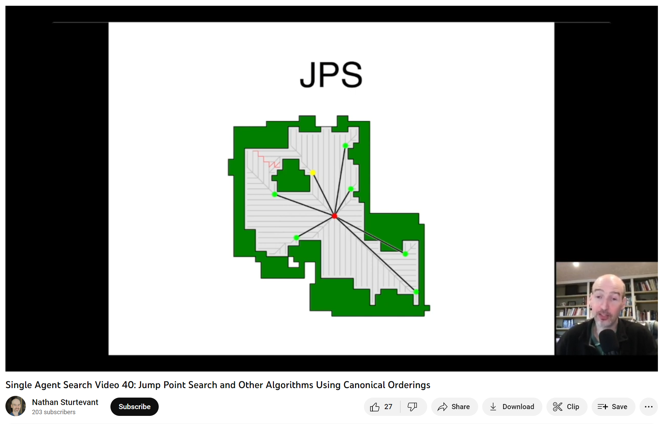
https://youtu.be/__ZLnTwYNPk

Slide 52
Goal Bounding

Slide 53
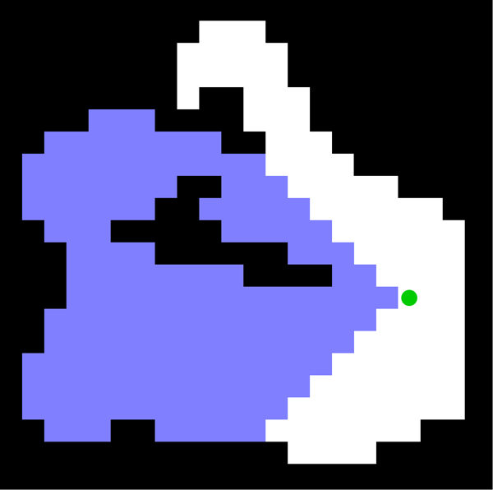

A* Search
Reachable optimally
by exploring left
Optimal goal bounds
when exploring left

Slide 54
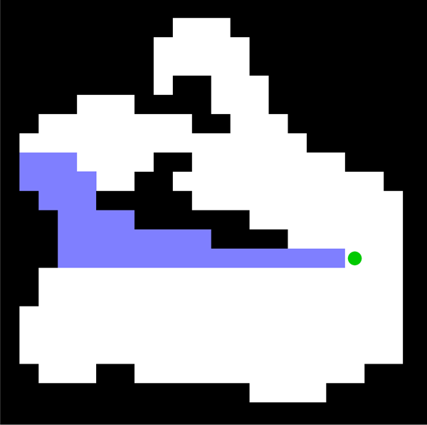

JPS+ Search
Reachable optimally
by exploring left
Optimal goal bounds
when exploring left

Slide 55
A* Search
Goal Bounds
JPS+ Search
Goal Bounds

Slide 56
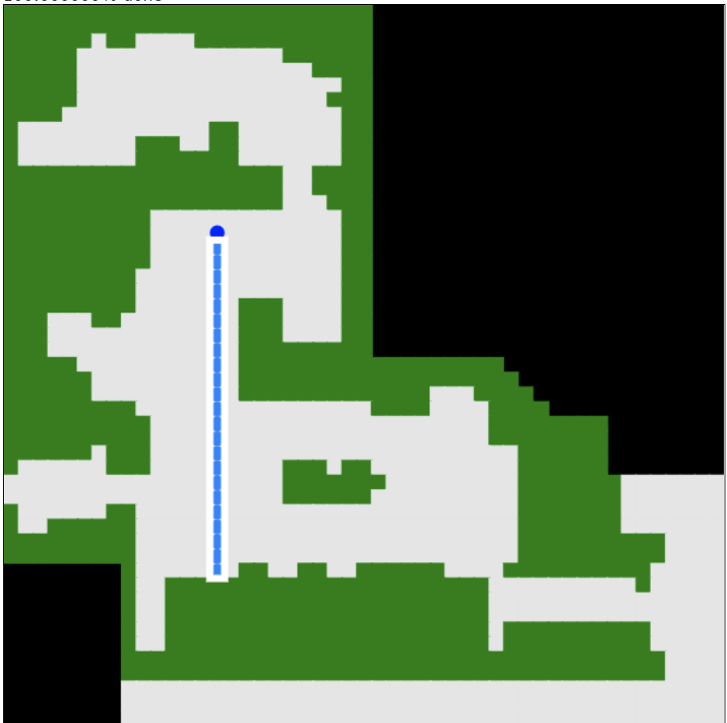
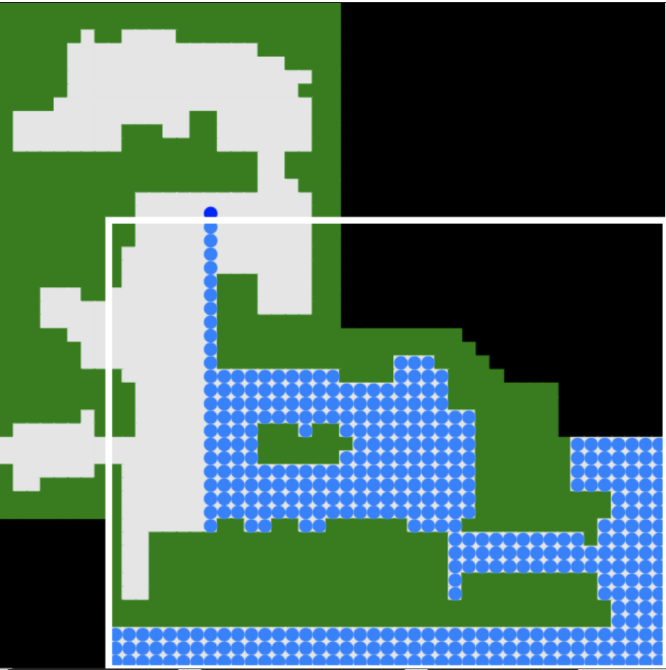
https://www.movingai.com/SAS/BBX/

Slide 57
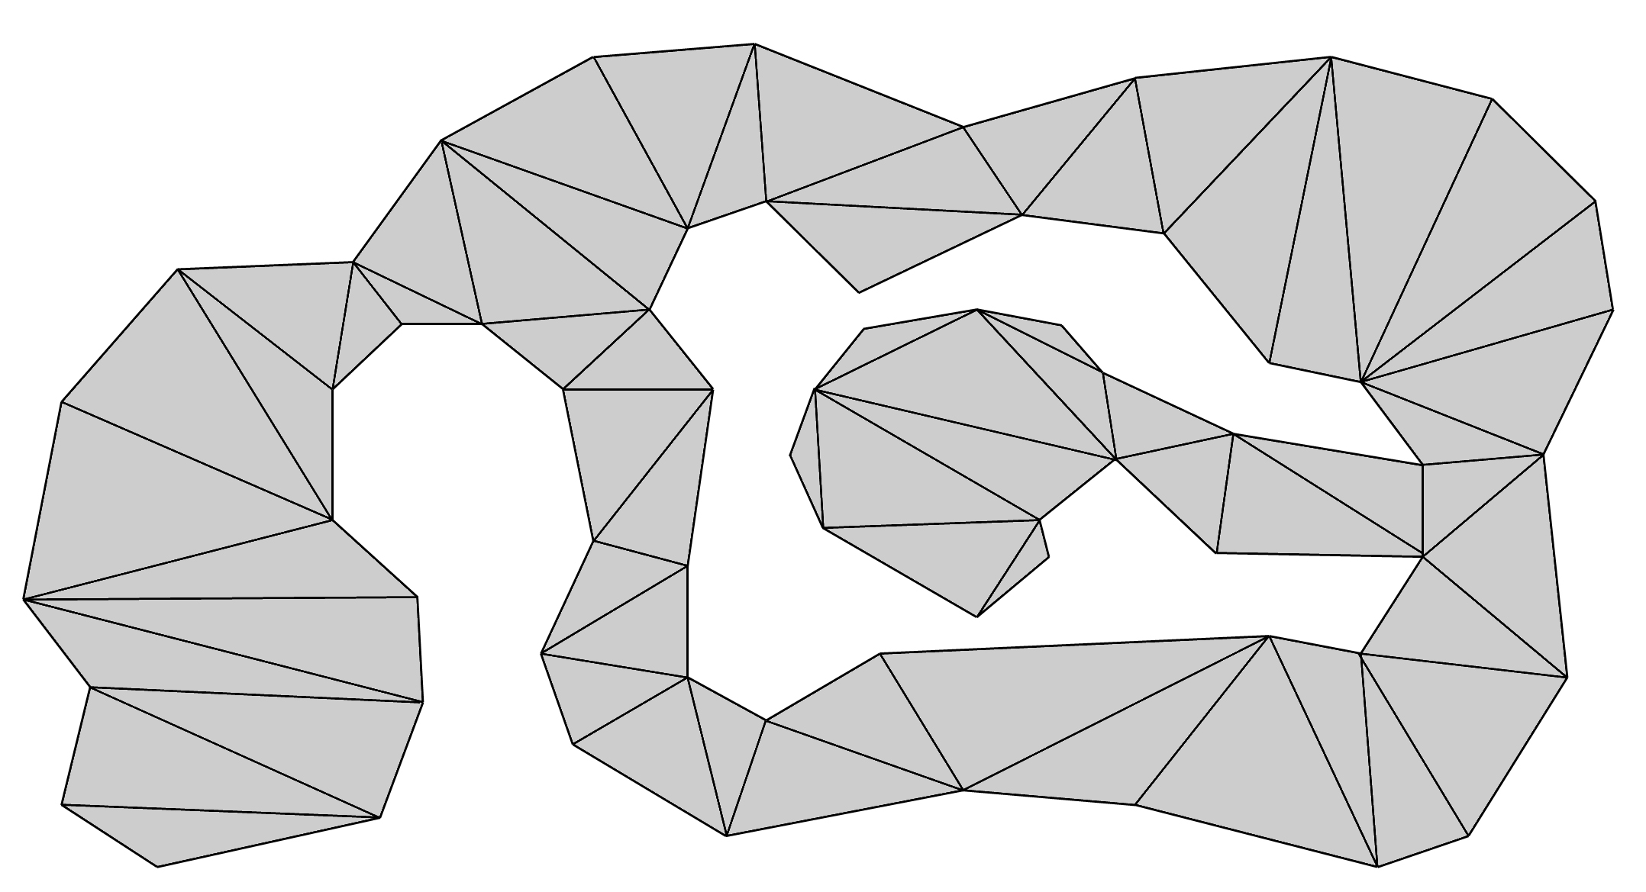
Goal Bounding
A* Search

Slide 58
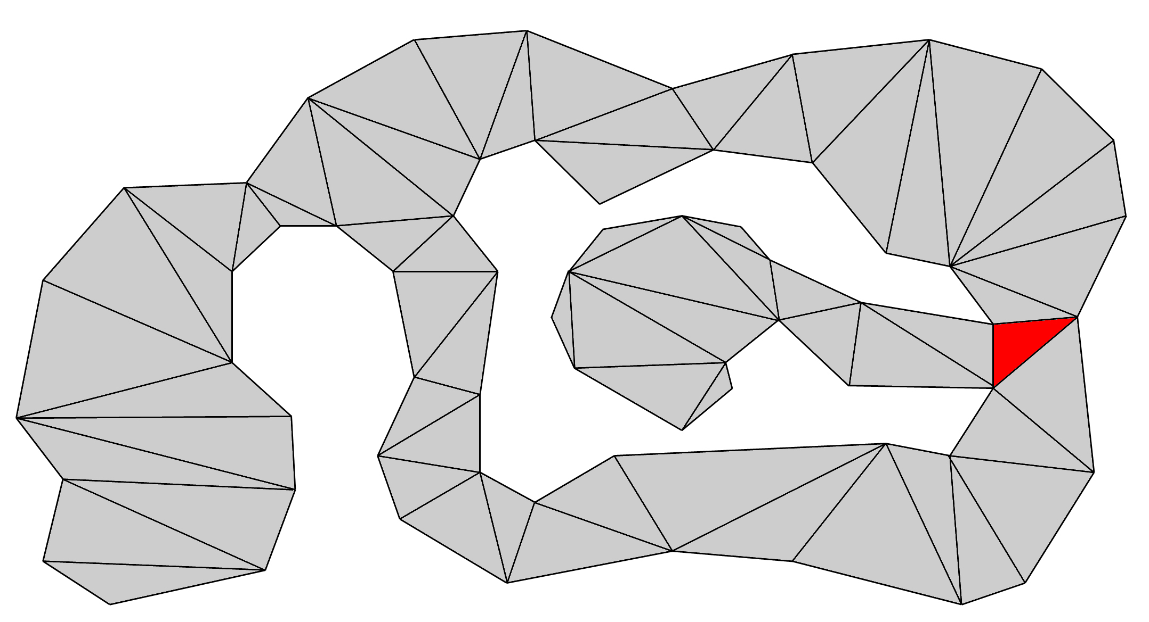
Goal Bounding
A* Search

Slide 59
Goal Bounding
A* Search

Slide 60
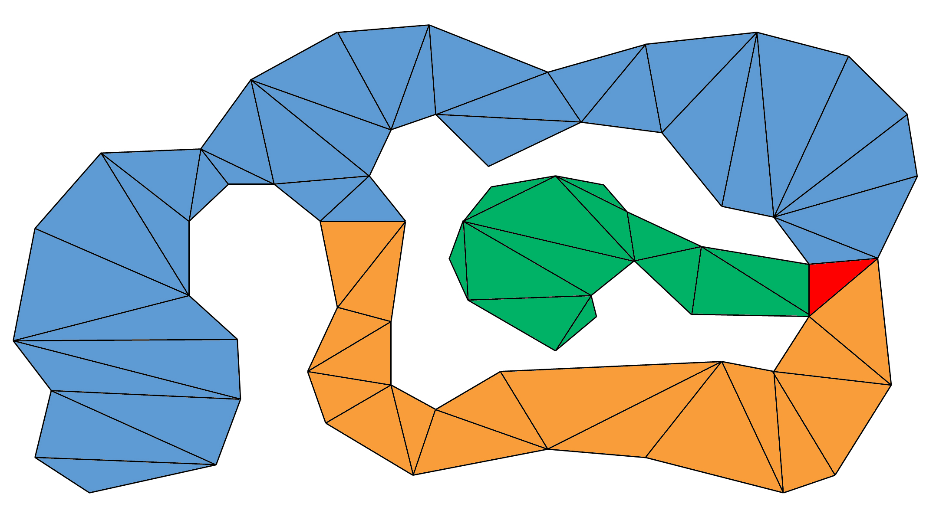
Goal Bounding
A* Search

Slide 61
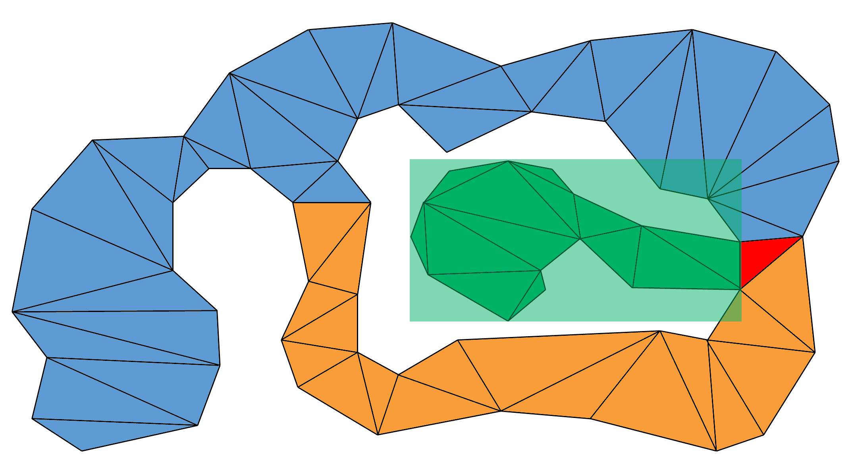
Goal Bounding
A* Search

Slide 62
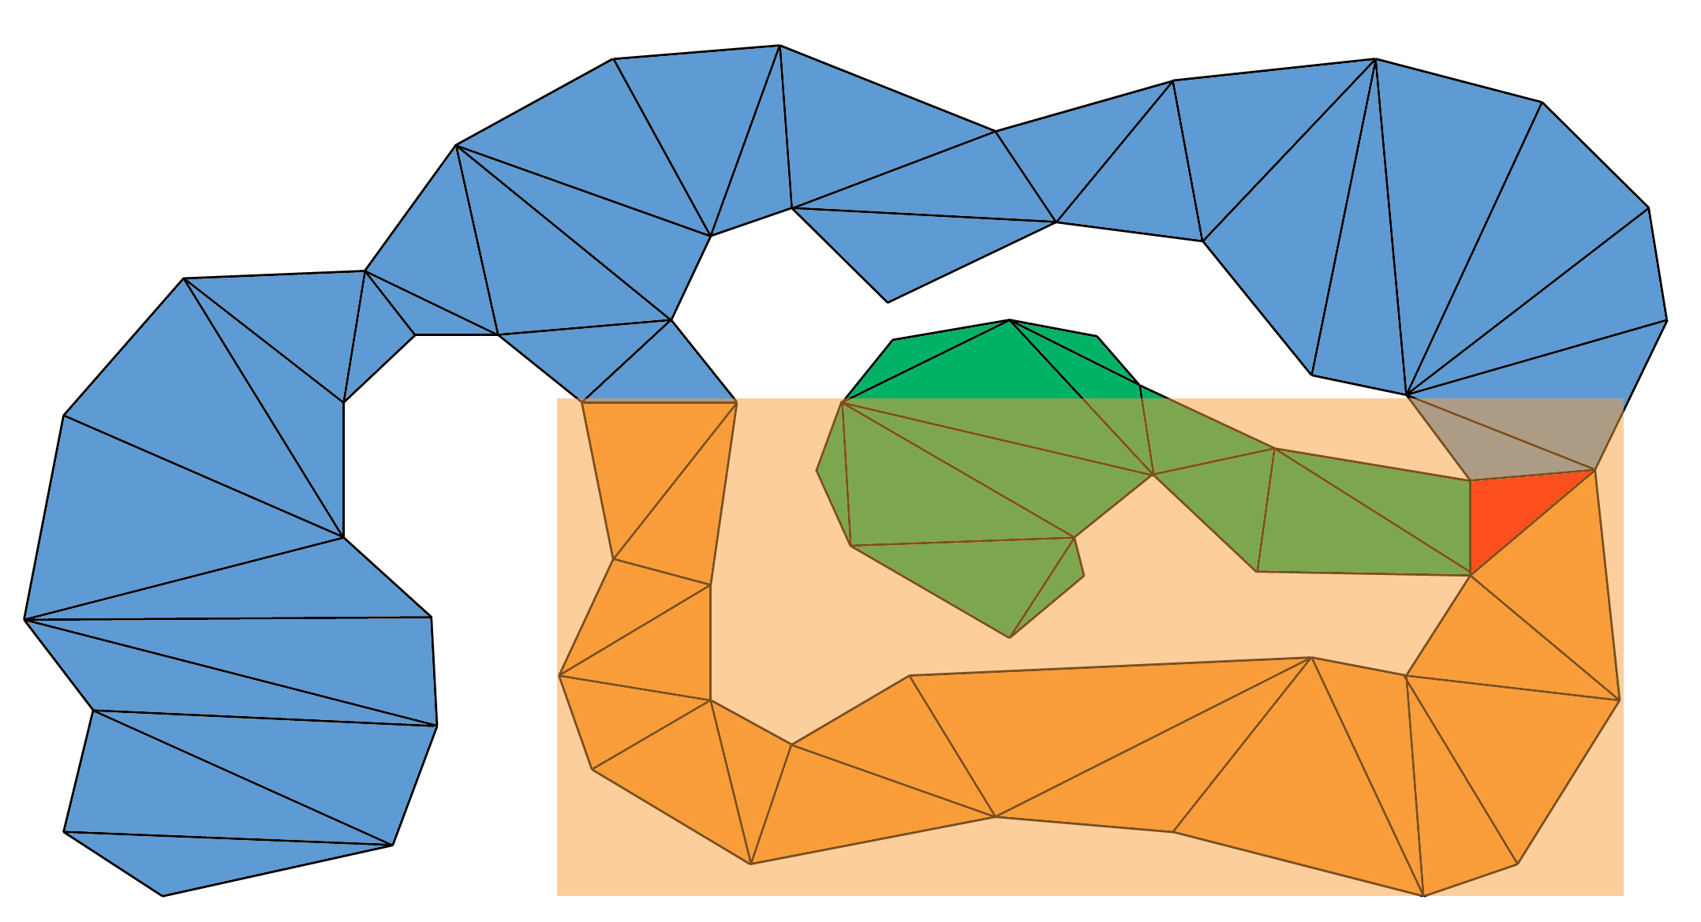
Goal Bounding
A* Search

Slide 63
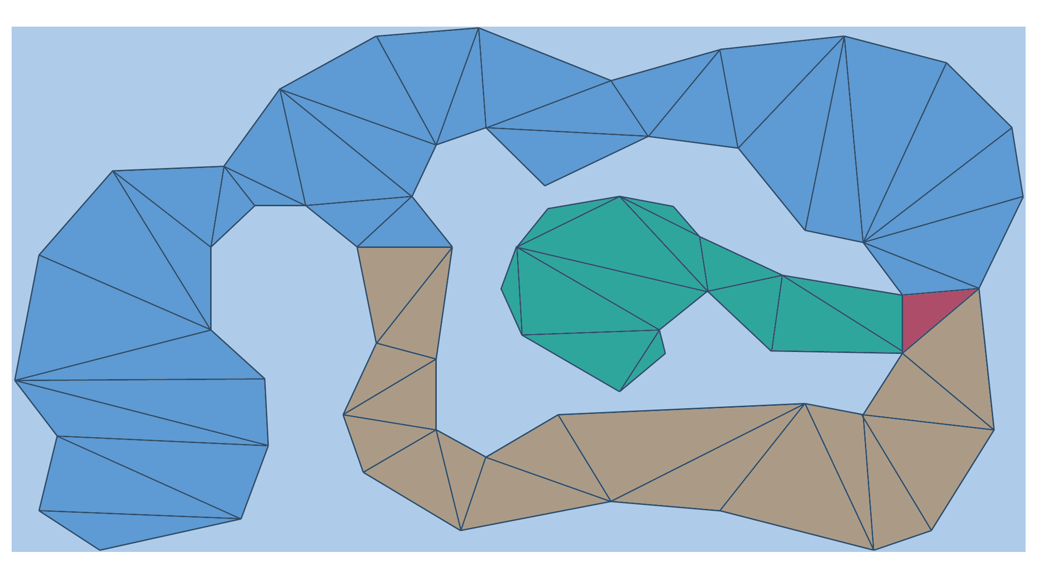
Goal Bounding
A* Search

Slide 64
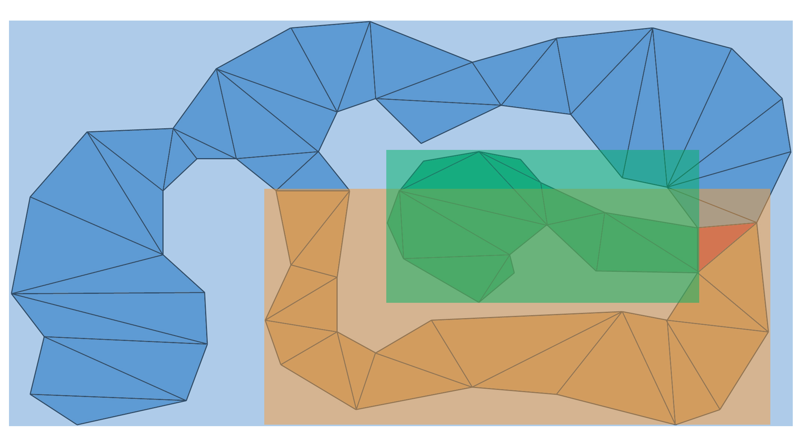
Goal Bounding
A* Search

Slide 65
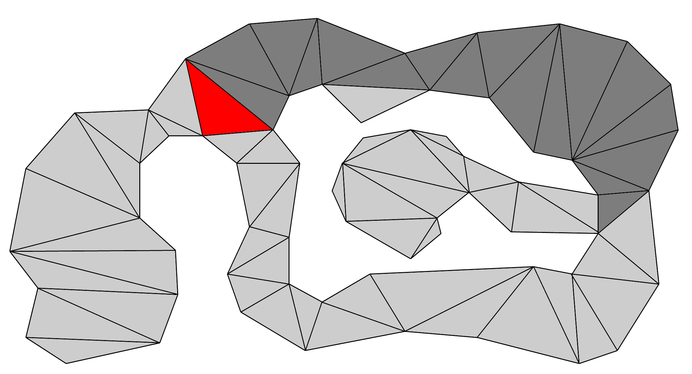
Goal Bounding
A* Search

Slide 66
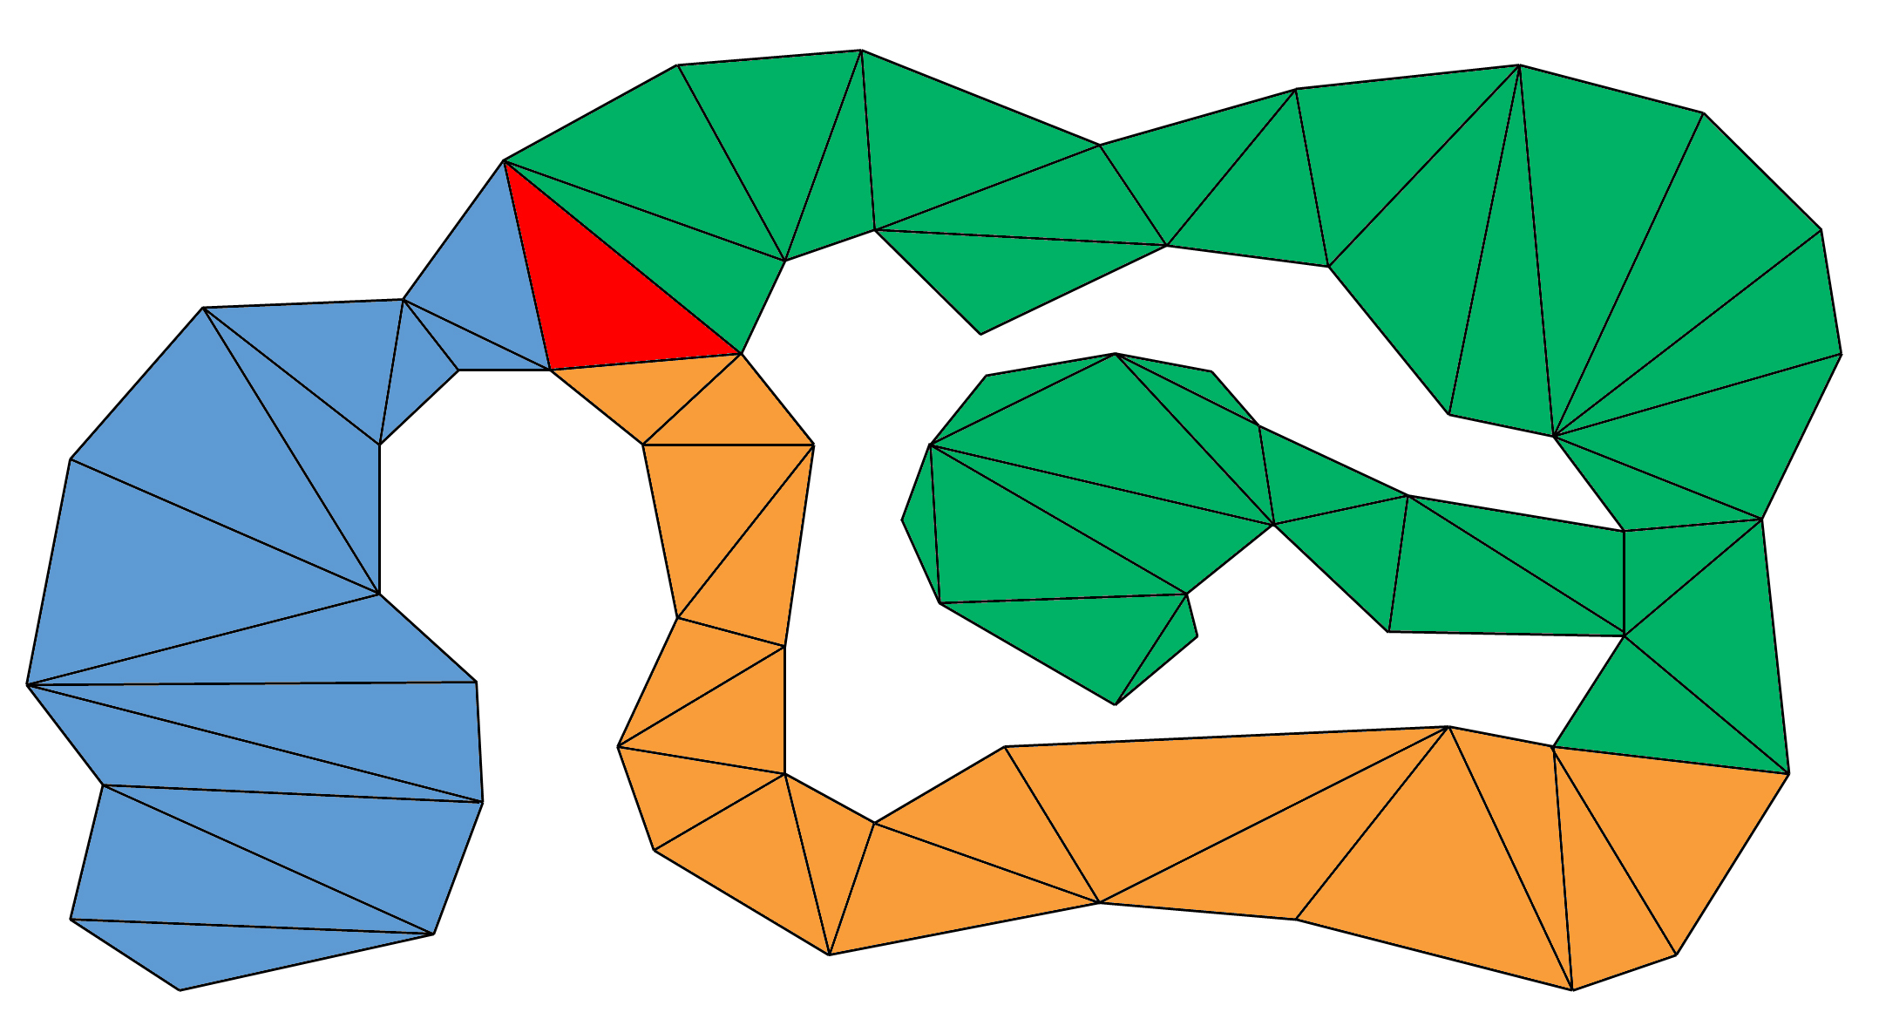
Goal Bounding
A* Search

Slide 67
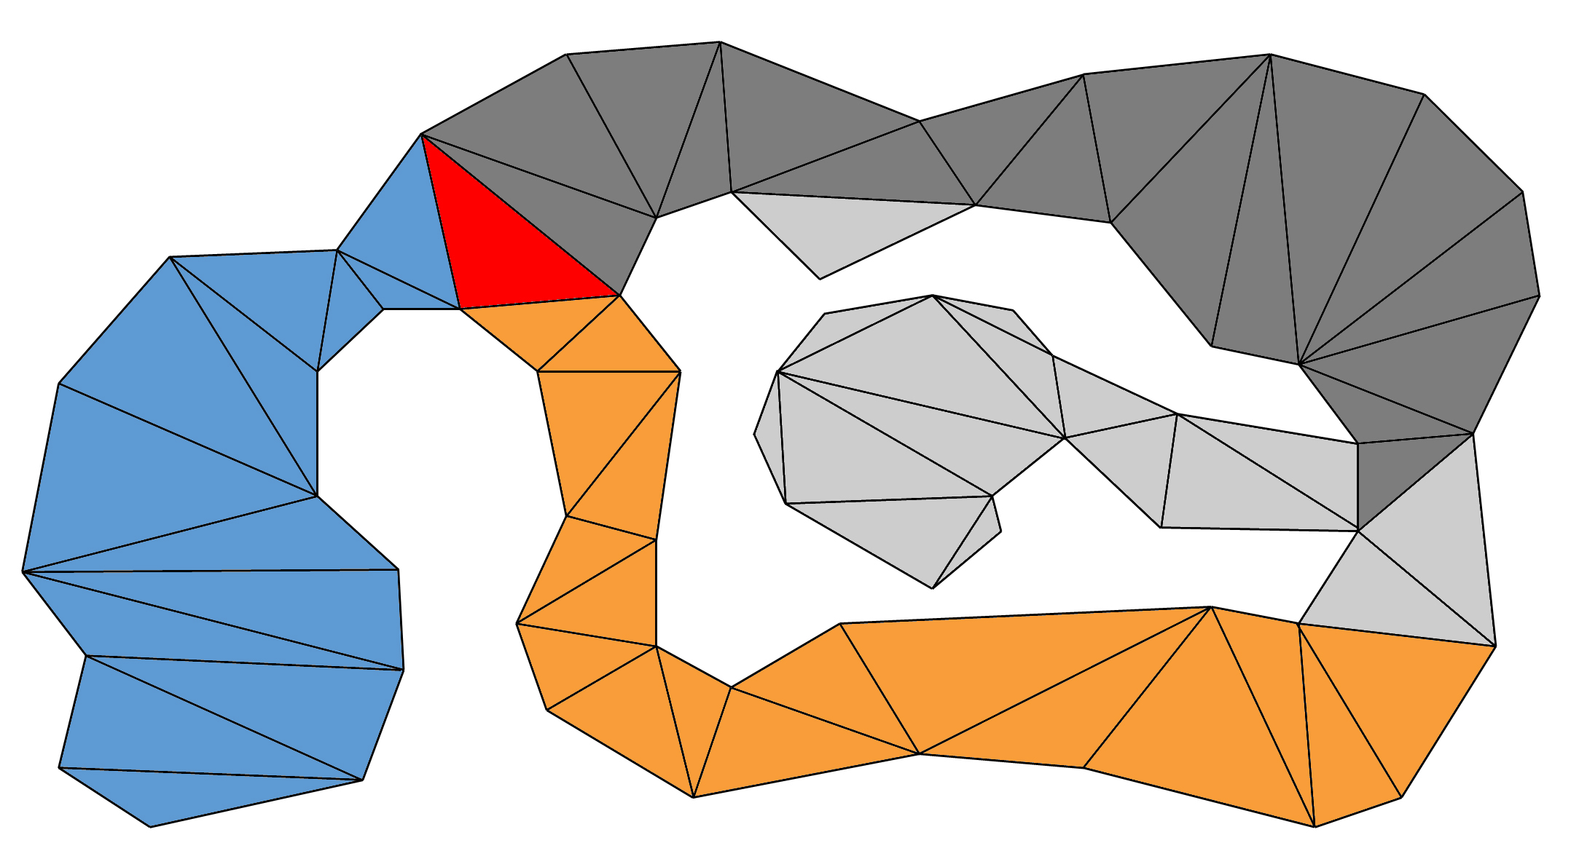
Goal Bounding
A* Search

Slide 68

Goal Bounding
A* Search

Slide 69

Goal Bounding
A* Search

Slide 71


Slide 72
How to calculate Goal Bounds
Dijkstra floodfill from each node
When you put a node on the Closed list
Update start node’s Goal Bounds
(for the edge it originally came from!)
Embarrassingly parallel

Slide 73
Calculating
Goal Bounds

Slide 74

Calculating
Goal Bounds

Slide 75

Calculating
Goal Bounds

Slide 76
Calculating
Goal Bounds

Slide 77
Calculating
Goal Bounds

Slide 78
Calculating
Goal Bounds

Slide 79
Calculating
Goal Bounds

Slide 80
Calculating
Goal Bounds

Slide 81
Calculating
Goal Bounds

Slide 82
Calculating
Goal Bounds

Slide 83
Calculating
Goal Bounds

Slide 84
Calculating
Goal Bounds

Slide 85
Calculating
Goal Bounds

Slide 86

Calculating
Goal Bounds

Slide 87

Calculating
Goal Bounds

Slide 88
Calculating
Goal Bounds

Slide 89
Calculating
Goal Bounds

Slide 90
Calculating
Goal Bounds

Slide 91
Calculating
Goal Bounds

Slide 92
Calculating
Goal Bounds

Slide 93
Calculating
Goal Bounds

Slide 94
Calculating
Goal Bounds

Slide 95
Calculating
Goal Bounds

Slide 96
Calculating
Goal Bounds

Slide 97
Calculating
Goal Bounds

Slide 98
Calculating
Goal Bounds

Slide 99
Calculating
Goal Bounds

Slide 100
Calculating
Goal Bounds

Slide 101
Calculating
Goal Bounds

Slide 102
Calculating
Goal Bounds

Slide 103
Calculating
Goal Bounds

Slide 104
Calculating
Goal Bounds

Slide 105
Calculating
Goal Bounds

Slide 106
Calculating
Goal Bounds

Slide 107
Calculating
Goal Bounds

Slide 108
Calculating
Goal Bounds

Slide 109
Calculating
Goal Bounds

Slide 110
Calculating
Goal Bounds

Slide 111
Calculating
Goal Bounds

Slide 112

Calculating
Goal Bounds

Slide 113

Calculating
Goal Bounds

Slide 114

Calculating
Goal Bounds

Slide 115

Calculating
Goal Bounds

Slide 116

Calculating
Goal Bounds

Slide 117
Optimizations

Slide 118
JPS+ Goal Bounding
Fast stack and unsorted Open list
Only works for grids using Octile heuristic

Slide 119

Across the Cape (768x768)
2940 tests
From 4.41 to 1176.61
Search | Max Open List Size | Avg Size On PopCheapest
A*
JPS+ GB

Slide 120
Across the Cape (768x768)
2940 tests
From 4.41 to 1176.61
Search | Max Open List Size | Avg Size On PopCheapest
A* | 3464
JPS+ GB

Slide 121
Across the Cape (768x768)
2940 tests
From 4.41 to 1176.61
Search | Max Open List Size | Avg Size On PopCheapest
A* | 3464 | 1204
JPS+ GB

Slide 122
Across the Cape (768x768)
2940 tests
From 4.41 to 1176.61
Search | Max Open List Size | Avg Size On PopCheapest
A* | 3464 | 1204
JPS+ GB | 11

Slide 123
Across the Cape (768x768)
2940 tests
From 4.41 to 1176.61
Search | Max Open List Size | Avg Size On PopCheapest
A* | 3464 | 1204
JPS+ GB | 11 | 3
3711x faster than A*

Slide 124
Arctic Station (768x768)
4100 tests
From 4 to 1643.06 long
Search | Max Open List Size | Avg Size On PopCheapest
A*
JPS+ GB

Slide 125
Arctic Station (768x768)
4100 tests
From 4 to 1643.06 long
Search | Max Open List Size | Avg Size On PopCheapest
A* | 4373 | 1154
JPS+ GB

Slide 126
Arctic Station (768x768)
4100 tests
From 4 to 1643.06 long
Search | Max Open List Size | Avg Size On PopCheapest
A* | 4373 | 1154
JPS+ GB | 8 | 1
4907x faster than A*

Slide 127
JPS+ Goal Bounding
Function pointer table
256 wall permutations X 8 parent directions
2048 look-up table pointing at 42 functions

Slide 128
Problem: Dynamic Maps

Slide 129
Goal Bounding
Gates

Slide 130
Goal Bounding
Gates

Slide 131
Goal Bounding
Gates

Slide 132
Recap

Slide 133
Goal Bounding
JPS+
70x to 350x
faster
1400x to 5000x
faster
20x to 60x
faster
Avoid
Redundant
Paths
Avoid
Wrong
Directions

Slide 134
Goal Bounding
1 value
Per Edge
4 values
Per Edge
JPS+
Grids, NavMesh, Graphs
Fast O(n)
Precompute
Slow O(n²)
Precompute
No Map
Changes
Dijkstra, A*,
other algorithms
Uniform
Cost
Avoid
Redundant
Paths
Avoid
Wrong
Directions
Non-Uniform
Cost

Slide 135
StarCraft Maps: Comparison
JPS+
Subgoal Graph
JPS+ Goal Bounds

Slide 136
Future Work
Can Goal Bounding work with Subgoal?
Can the precompute be done in O(n)?
Are there better bounds than a box?
How much does it actually speed up A* on a NavMesh?

Slide 137
Questions?
steve.rabin@gmail.com
Email me for source code
Slides at:
www.gameaipro.com

